Slide 1
.Net Core Template
Amit Jangid

Slide 2
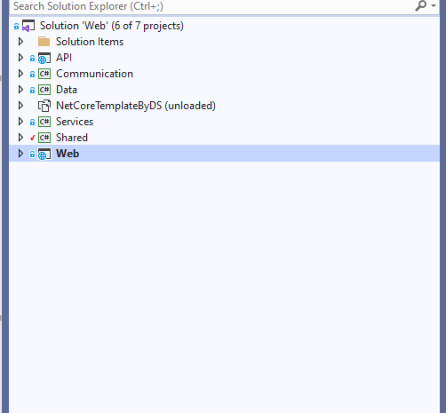
Create Multiple Project with all functionality

Slide 3
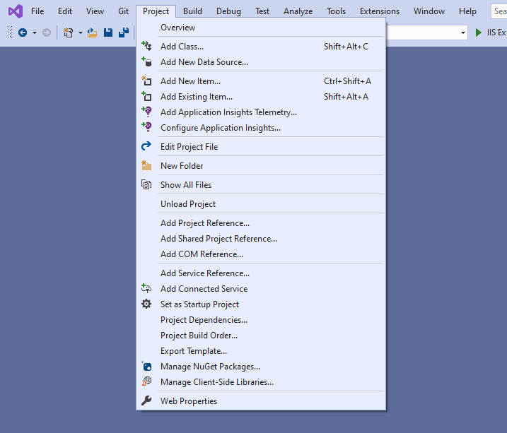
Go To Export Template option A Popup will appear of Export Template Wizard.
Export All Project one by one

Slide 4
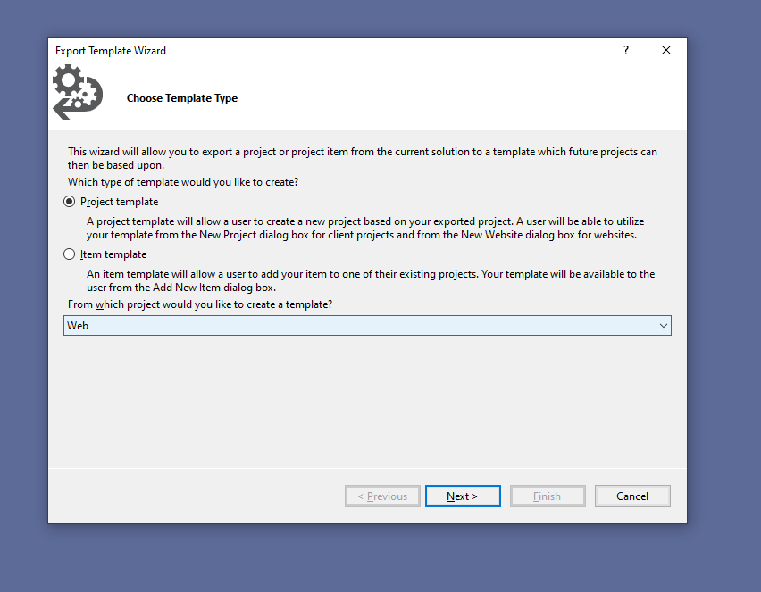
Export template Wizard
Choose Project Template radio button.
Select the project of which you want to create the template.
Click on Next.

Slide 5
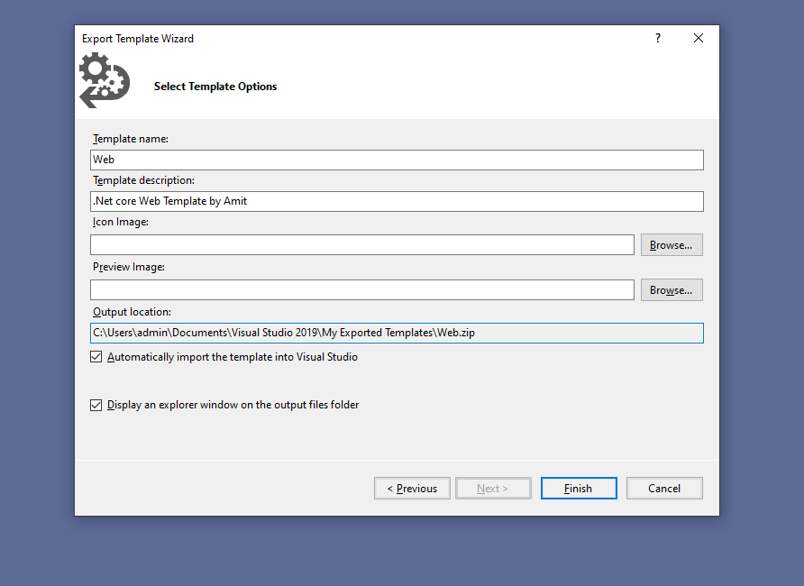
Export template Wizard
Fill All required details in form.
Go To Output location displayed below in Form.
Repeat the same steps for all remaining project like Shared,Data,Services, API Layer Projects.

Slide 6
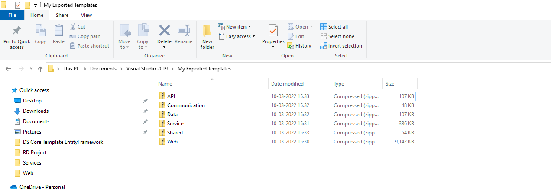
Output Location (C:\Users\admin\Documents\Visual Studio 2019\My Exported Templates\Web.zip)
1. After Exporting All the project those project will compressed to the above location.
2. After that Extract them and combine them in a single folder. And Generate Vs Template file int that folder.

Slide 7
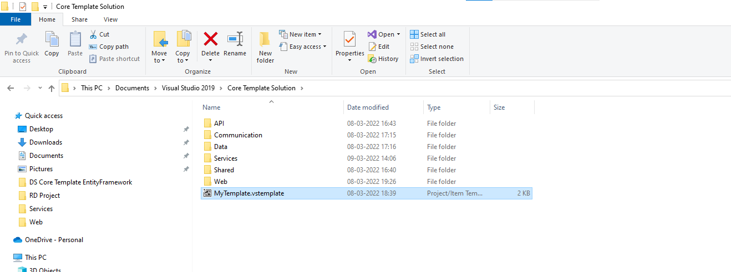
Extracted project in a single folder with vs template file

Slide 8
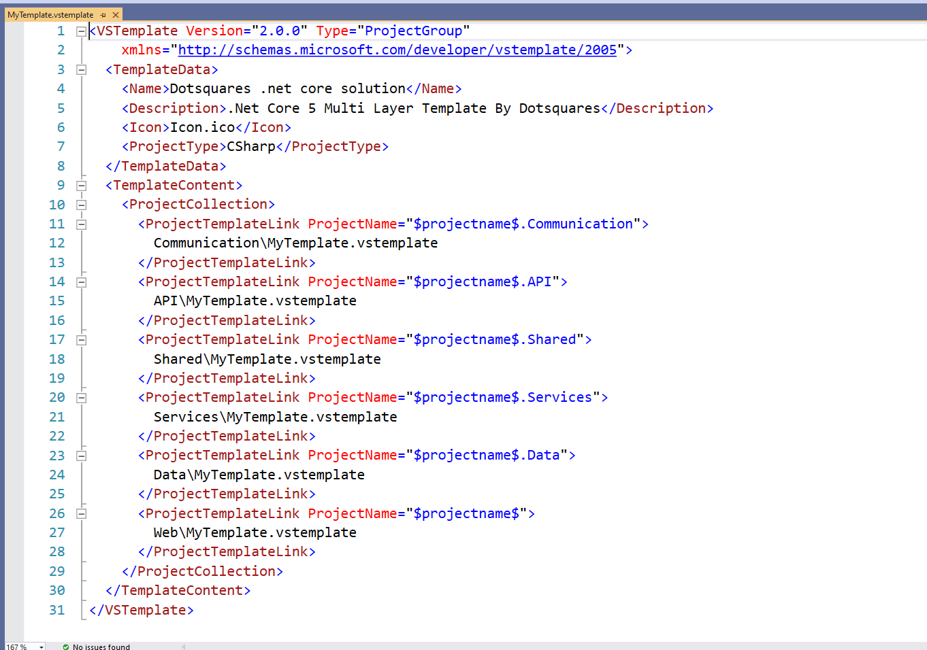
Parent Folder’s Vs Template File Content

Slide 9
<VSTemplate Version="2.0.0" Type="ProjectGroup"
xmlns="http://schemas.microsoft.com/developer/vstemplate/2005">
<TemplateData>
<Name>Dotsquares .net core solution</Name>
<Description>.Net Core 5 Multi Layer Template By Dotsquares</Description>
<Icon>Icon.ico</Icon>
<ProjectType>CSharp</ProjectType>
</TemplateData>
<TemplateContent>
<ProjectCollection>
<ProjectTemplateLink ProjectName="$projectname$.Communication">
Communication\MyTemplate.vstemplate
</ProjectTemplateLink>
<ProjectTemplateLink ProjectName="$projectname$.API">
API\MyTemplate.vstemplate
</ProjectTemplateLink>
<ProjectTemplateLink ProjectName="$projectname$.Shared">
Shared\MyTemplate.vstemplate
</ProjectTemplateLink>
<ProjectTemplateLink ProjectName="$projectname$.Services">
Services\MyTemplate.vstemplate
</ProjectTemplateLink>
<ProjectTemplateLink ProjectName="$projectname$.Data">
Data\MyTemplate.vstemplate
</ProjectTemplateLink>
<ProjectTemplateLink ProjectName="$projectname$">
Web\MyTemplate.vstemplate
</ProjectTemplateLink>
</ProjectCollection>
</TemplateContent>
</VSTemplate>

Slide 10
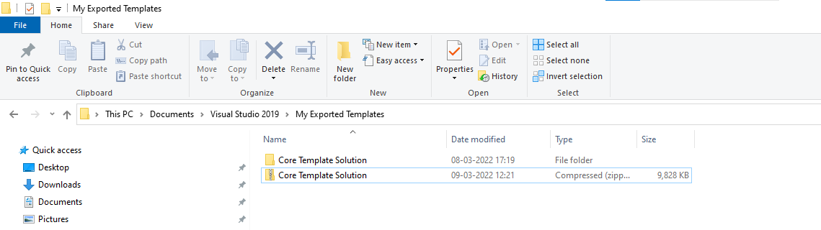
Compressed the parent folder of All project.

Slide 11
Next Part! Create VSIX project for Extension

Slide 12
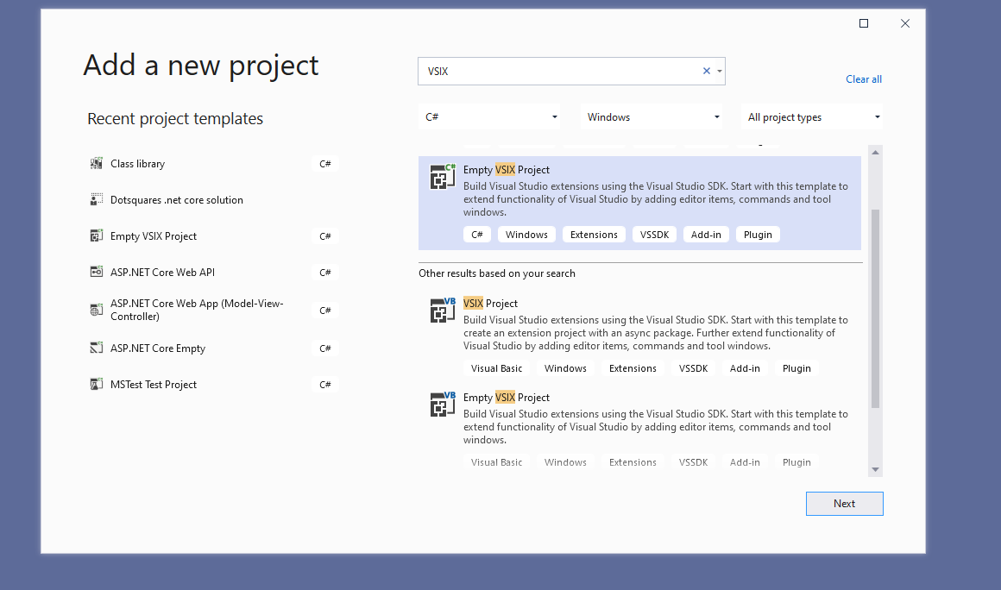
Empty VSIX Project

Slide 13
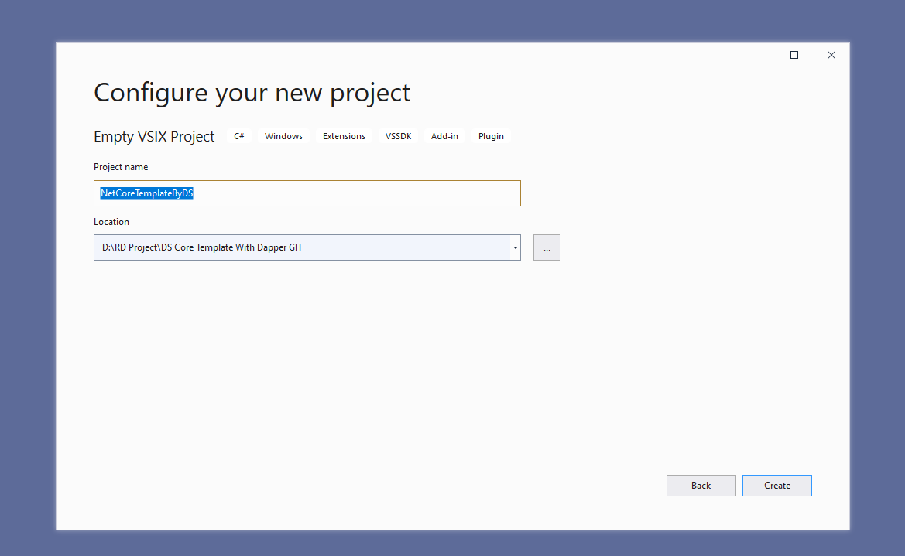
Configure VSIX (Visual Studio Extension) Project

Slide 14
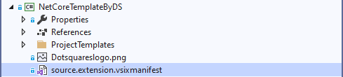
After Creation project
By Default It will generate source.extension.vsixmanifest file open this file.

Slide 15
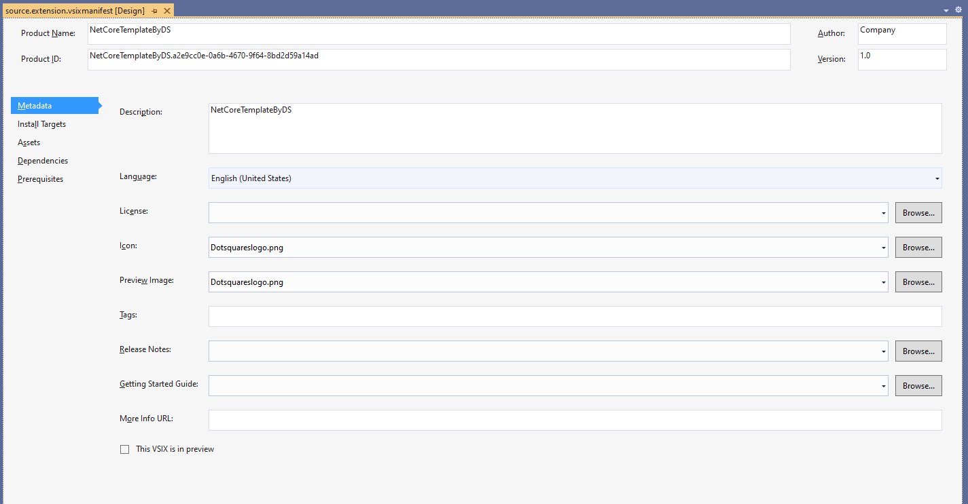
Fill All the required details in Metadata form.

Slide 16
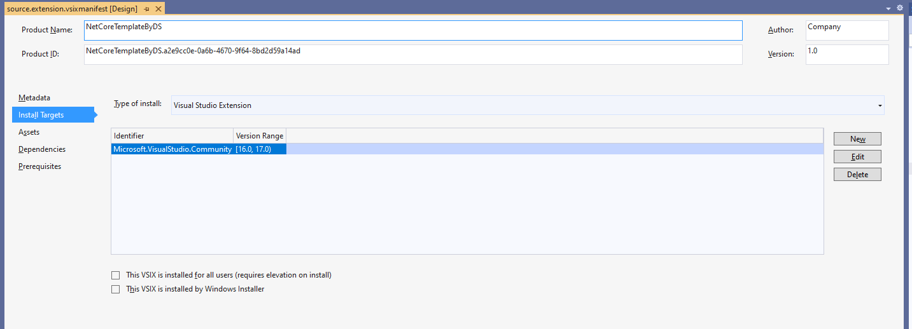
Install Targets (By Default you can leave as it is)

Slide 17
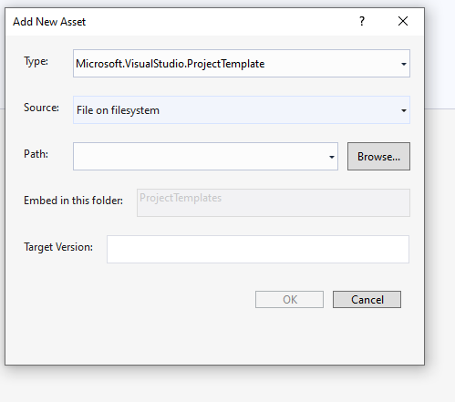
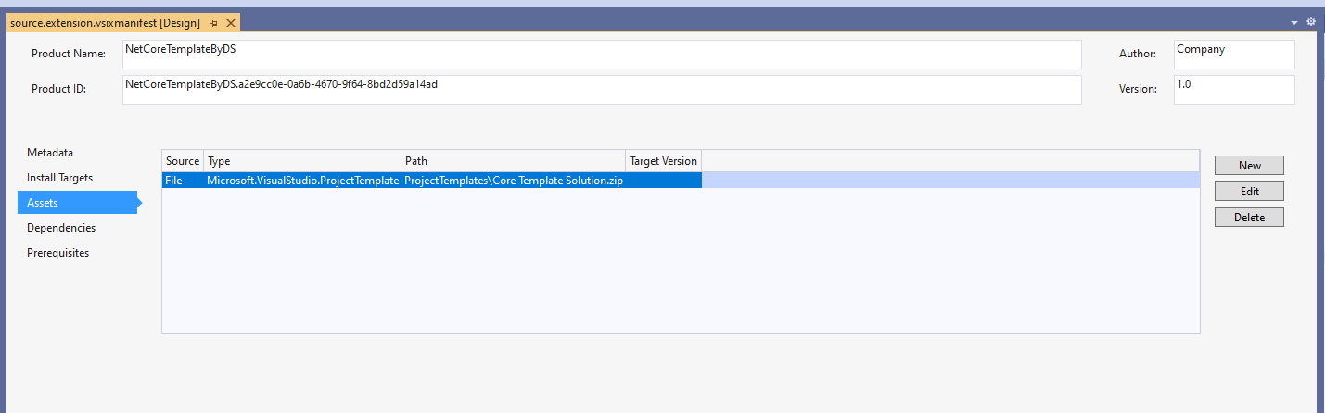
Assets
Click New And select the generated compressed file

Slide 18
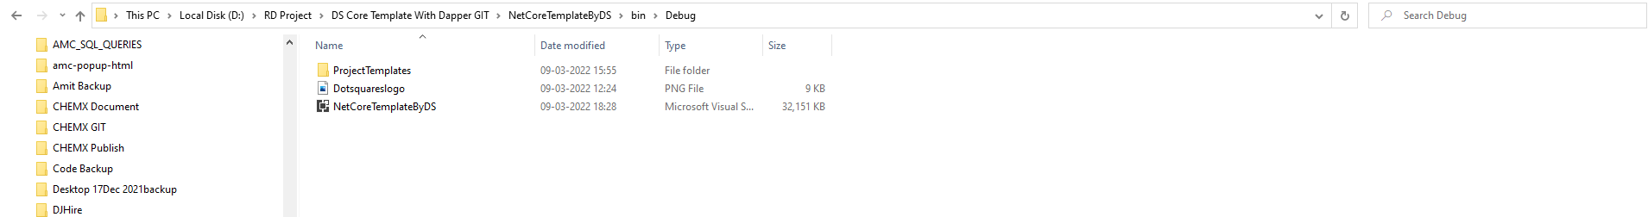
And the rest option leave them As it is.
Build the solution .
Then go to NetCoreTemplateByDS\bin\Debug folder. It will show you the generated extension file.

Slide 19
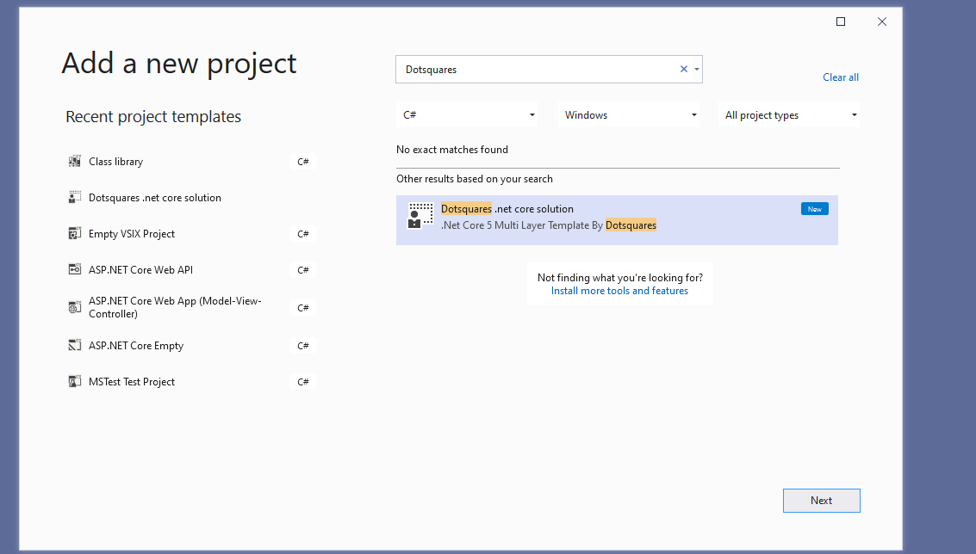
All Set!!!
Now anybody can install extension in their visual studio.
And the custom template will display in their template list.

